Slide 1
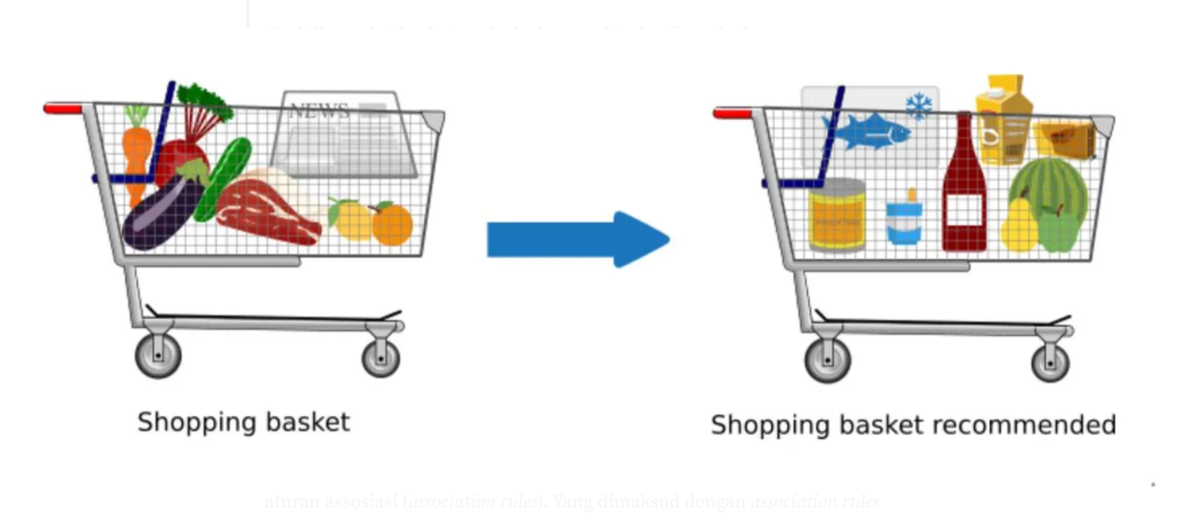
Market Basket Analysis
Key Concepts and Applications
Evan McLaughlin, Beshkia Kvarnstrom, Vladimir Nimchenko, Victor Torres,
Nikoleta Emanouilidi
Source

Slide 2
Introduction to Market Basket Analysis
What is Market Basket Analysis?
Market Basket Analysis (MBA) is a data mining technique that identifies patterns in transactional data to understand the co-occurrence of items purchased together. By analyzing these relationships, businesses gain insights into customer purchasing behavior, enabling more effective product recommendations, bundling strategies, and inventory management.
The main objective of MBA is to identify product associations and insights to improve marketing/sales strategies, and customer experience/engagement.
Market Basket Analysis (MBA) is widely used across industries to uncover customer behavior patterns and optimize operations.
Objective
Typical Application

Slide 3
Applications of Market Basket Analysis
Retail Industry: Understand customer buying patterns to optimize store layout and product placement.
E-commerce: Product recommendations and upselling opportunities.
Inventory Management: Manage stock based on frequently bought item pairs or sets.
Marketing and Promotions: Bundle products or offer targeted discounts.
Financial Services: Fraud detection.
Telecommunication: Offering bundled services.

Slide 4
Core Concepts of Market Basket Analysis
Market Basket Analysis revolves around discovering patterns and associations in transactional data.
At the heart of Market Basket Analysis lies the concept of Association Rules. Association Rules are used to identify patterns of co-occurrence in transactional data.
A→B
A (Antecedent): The item(s) on the left-hand side of the rule.
B (Consequent): The item(s) on the right-hand side of the rule.
If-then statements e.g., {Bread} → {Butter} ("If a customer buys Bread, they are likely to buy Butter.")

Slide 5



Metrics to Evaluate Association Rules
Support – This is the proportion of transactions containing both antecedent (A) and consequent (B). Its purpose is to measure the frequency of the rule in the dataset.
Confidence - This is the likelihood of purchasing consequent BBB, given antecedent AAA. Used to indicate the strength of the rule.
Lift - The strength of the association between AAA and BBB, compared to their independence.

Slide 6
Mining Association Rules
Overview of the Apriori Algorithm and Challenges in Market Basket Analysis
What are Association Rules?
Rules that identify patterns or relationships in large datasets, commonly used in market basket analysis.
Example:
If {diapers} are purchased, then {beer} is likely purchased too.
APRIORI ALGORITHM
Definition
Apriori identifies frequent itemsets by leveraging the "downward closure property": if an itemset is not frequent, its supersets cannot be frequent either.
Simpler
The Apriori algorithm finds frequent itemsets using a simple rule: if a smaller group of items isn't popular, then bigger groups that include those items can't be popular either.

Slide 7
Overview of the Apriori Algorithm
Iterative Process s:
Generate candidate itemsets from transactions.
Calculate support for each itemset.
Eliminate itemsets below the minimum support threshold.
Use frequent itemsets to generate association rules with thresholds for confidence and lift.
Example Application:
Grocery Store Analysis:
  Transaction data: {Milk, Bread, Butter}.
  Rule: {Milk, Bread} → {Butter}.
  Support = 50%, Confidence = 80%, Lift = 1.5.
from mlxtend.frequent_patterns import apriori, association_rules
# One-hot encoded data
transactions = pd.DataFrame([
{'Milk': 1, 'Bread': 1, 'Butter': 1},
{'Milk': 1, 'Bread': 1, 'Butter': 0},
{'Milk': 0, 'Bread': 1, 'Butter': 1},
{'Milk': 1, 'Bread': 0, 'Butter': 1}
])
# Apriori Algorithm
frequent_itemsets = apriori(transactions, min_support=0.5, use_colnames=True)
rules = association_rules(frequent_itemsets, metric="confidence", min_threshold=0.7)
# Example Rule
rule = rules[(rules['antecedents'] == frozenset({'Milk', 'Bread'})) &
(rules['consequents'] == frozenset({'Butter'}))]
print(rule)

Slide 8
Challenges in Market Basket Analysis
Key Challenges in Market Basket Analysis
1. Large Volume of Rules
Challenge: Market Basket Analysis often generates thousands of association rules, which can overwhelm analysts. Among this vast number, only a few are genuinely meaningful or actionable. For instance:
  A grocery dataset might produce rules like:
    {Bread, Milk} → {Butter}
    {Eggs, Cheese} → {Milk}
    {Chips, Soda} → {Candy}
  While some of these rules provide useful insights, others might be too numerous or irrelevant to act upon.
Solution: To manage this, filtering techniques can be applied:
  Lift: Prioritize rules where the lift value exceeds 1, indicating a significant relationship. For example:
    {Milk, Bread} → {Butter} with Lift = 1.5 is more meaningful than a rule with Lift = 0.8.
2. Redundant or Obvious Rules
Challenge: Many rules might be redundant or intuitively obvious, offering no new insights. For example:
  {Milk} → {Bread} is trivial in a grocery store context because these items are commonly bought together.
  Redundancy arises when rules are subsets of larger, more comprehensive rules:
    {Milk, Bread} → {Butter}
    {Bread} → {Butter}
Solution: Advanced pruning strategies are necessary to eliminate such redundancies:
  Chi-Square Testing: Measure the statistical significance of each rule, retaining only those with p-values below a certain threshold.
  Maximal Frequent Itemsets: Focus on the largest frequent itemsets and derive rules from these, avoiding subsets that add little value.

Slide 9
Challenges in Market Basket Analysis
3. Parameter Sensitivity
Challenge: The results of Market Basket Analysis heavily depend on chosen thresholds for support, confidence, and lift:
  Setting a high minimum support might ignore rare but valuable associations. For example, {Luxury Wine, Caviar} might appear infrequently but could provide crucial insights for high-end customers.
  Low confidence thresholds might introduce irrelevant rules, reducing trust in the analysis.
Solution: Experimentation and optimization are key:
  Grid Search Optimization: Test various combinations of support and confidence thresholds to find the best parameters for the dataset.
  Domain Expertise: Adjust thresholds based on the dataset context. For instance, in luxury retail, focus on high-value but infrequent transactions, lowering support while maintaining high confidence.
Challenge: Lift measures how much more likely an association is compared to random chance. A low lift (e.g., close to 1) might indicate weak or coincidental relationships.
  For instance:
    {Milk} → {Bread} might have high confidence but a lift close to 1, suggesting it doesn’t occur much more frequently than expected by chance.
Solution:
  Set lift thresholds: Introduce a minimum lift parameter (e.g., Lift > 1.2) to filter out statistically weak relationships.

Slide 10
Alternative Approaches
Network-Based Analysis: Modeling transactions as a product network to identify communities.
A Product Network is a model where a vertex represents a product and an edge represents a relationship between them in a dataset.
The aim is to detect a pattern in which the customers will buy additional products if we promote the #1 product. This plan can be implemented by applying a discount strategy for product #1 or putting it on the same shelf or page of brochure with the other products we want to sale.
Community Detection: Finding clusters of products bought together to improve analysis.
Community detection is the process of grouping nodes in a network based on their internal connections, with the goal of finding clusters that are more densely connected internally than externally.
Community detection can be either centralized or distributed, depending on whether the whole network graph is required or only a part of it is required by the entity that performs the community detection

Slide 11
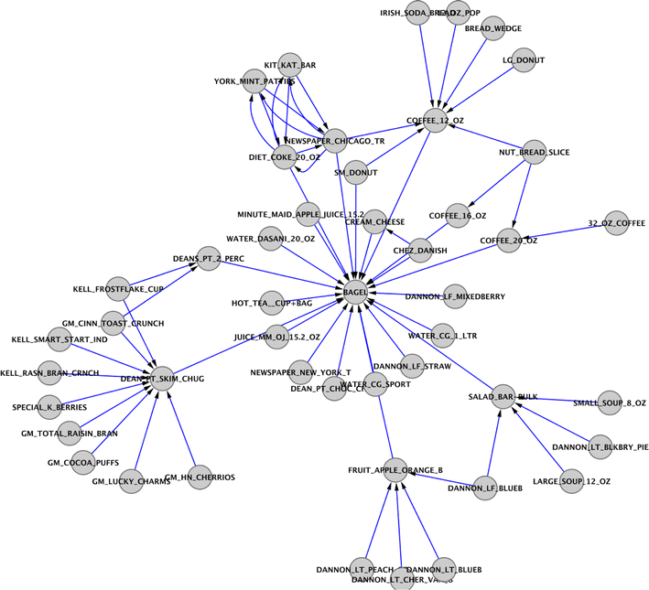
Network-Based Analysis
By modeling the data as a product network, we discover expressive communities (clusters) in the data, which can then be targeted for further analysis. We demonstrate that our network based approach can concisely isolate influence among products, mitigating the need to search through massive lists of association rules. We develop an interestingness measure for communities of products and show that it isolates useful, actionable communities. Finally, we build upon our experience with product networks to propose a comprehensive analysis strategy by combining both traditional and network-based techniques. This framework is capable of generating insights that are difficult to achieve with traditional analysis methods.

Slide 12
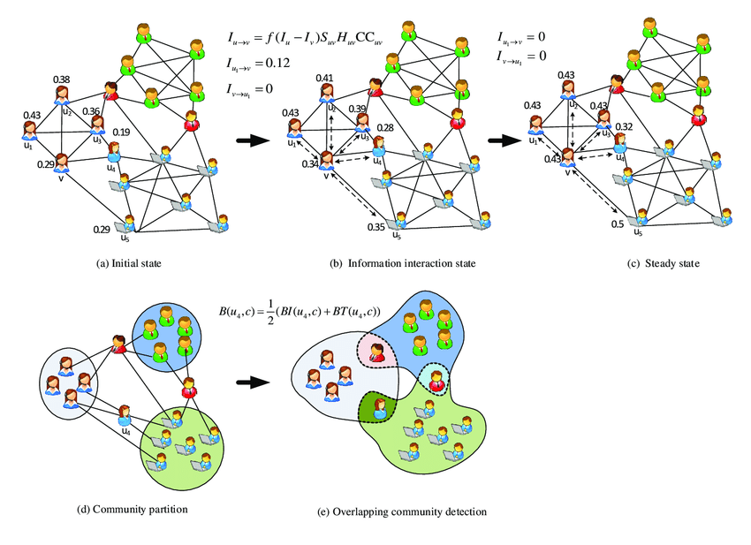
Community Detection
Community detection is a fundamental problem in social network analysis consisting, roughly speaking, in unsupervised dividing social actors (modeled as nodes in a social graph) with certain social connections (modeled as edges in the social graph) into densely knitted and highly related groups with each group well separated from the others.
Community detection can be used in machine learning to detect groups with similar properties and extract groups for various reasons. For example, this technique can be used to discover manipulative groups inside a social network or a stock market.

Slide 13
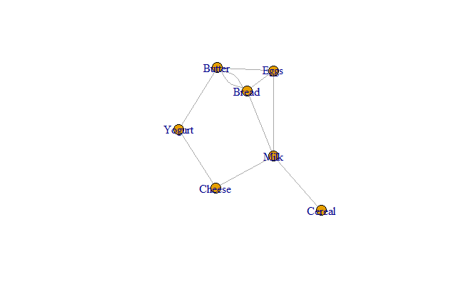
Network-Based Analysis and Community Detection in R
grocery_edges <- data.frame(
Source = c("Milk", "Bread", "Milk", "Eggs", "Bread", "Cheese", "Butter", "Eggs", "Cereal", "Bread"),
Target = c("Bread", "Eggs", "Cheese", "Butter", "Butter", "Yogurt", "Yogurt", "Milk", "Milk", "Butter"),
Weight = c(3, 2, 1, 5, 4, 2, 3, 4, 2, 6) )
unique_items <- unique(c(grocery_edges$Source, grocery_edges$Target))
grocery_prices <- data.frame(
Item = unique_items,
Price = c(2.5, 1.2, 2.0, 0.8, 3.5, 4.0, 3.8) # Adjust to match the 7 unique items
)
grocery_graph <- graph_from_data_frame(grocery_edges, directed = FALSE)
V(grocery_graph)$price <- grocery_prices$Price[match(V(grocery_graph)$name, grocery_prices$Item)]
# Create a graph from the edge list
grocery_graph <- graph_from_data_frame(grocery_edges, directed = FALSE)
plot(grocery_graph)

Slide 14
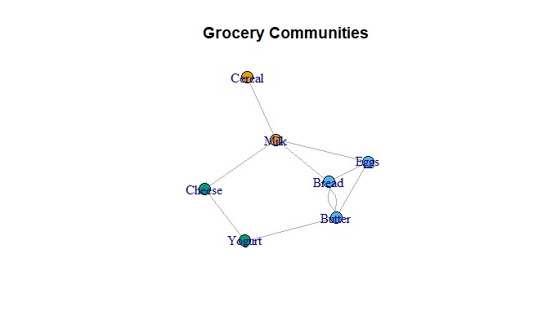
Network-Based Analysis and Community Detection in R
# Use the Louvain algorithm
communities <- cluster_louvain(grocery_graph)
# Print community memberships
membership(communities)
Milk Bread Eggs Cheese Butter Cereal Yogurt
1 2 2 3 2 1 3
# Visualize communities
plot(grocery_graph, vertex.color = membership(communities), main = "Grocery Communities")

Slide 15
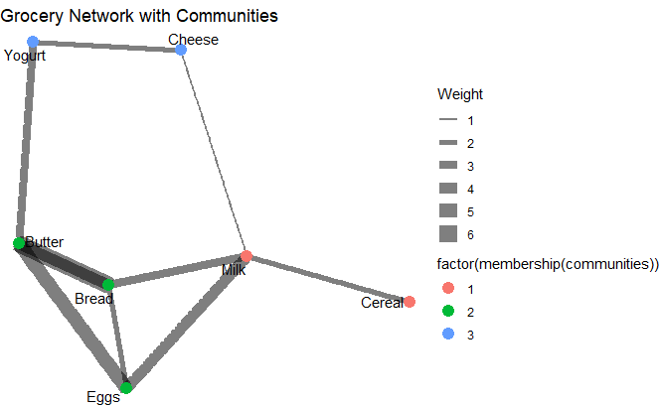
Network-Based Analysis and Community Detection in R
tidy_grocery_graph <- as_tbl_graph(grocery_graph)
# Visualize with ggraph
ggraph(tidy_grocery_graph, layout = "fr") +
geom_edge_link(aes(edge_width = Weight), alpha = 0.5) +
geom_node_point(aes(color = factor(membership(communities))), size = 4) +
geom_node_text(aes(label = name), repel = TRUE) +
theme_void() +
ggtitle("Grocery Network with Communities")

Slide 16
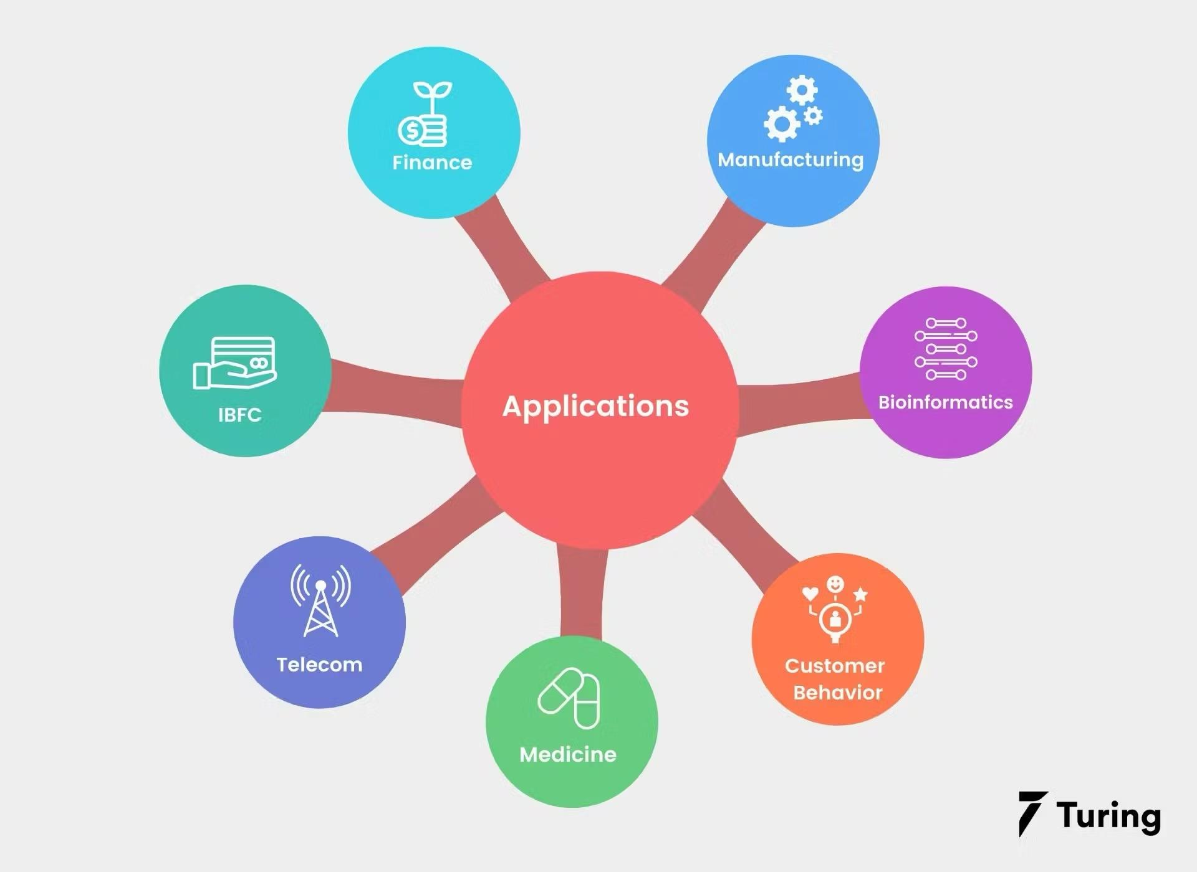
Applications Beyond Retail
Finance: Fraud detection related to credit card usage
Manufacturing: Failure prediction of equipment
Medicine: Determination of symptom analysis and comorbid conditions
Telecom: Bundling tv and internet packages to reduce churn
Notes:
POWERPOINT LAYOUT: TWO CONTENT
Image size 5.5” wide x 3” tall @ 96 ppi [528x288 pixels]

Slide 17

Applications Beyond Retail
Finance
Examine a combination of items in a single transaction and compare to a buyer’s regular purchasing habits. Anomalies such as high priced items from other countries may indicate fraud
Identify transactions which deviate from a buyer’s historical purchasing behavior, such as: buying from categories they never brought from before or making a large purchase in a short period of time
Implement Apriori algorithm to identify association rules between different purchases in order to capture unusual combinations of purchases.
Utilize dimensionality reduction by grouping purchases together and creating broader categories in order to speed up the fraud detection process
Notes:
POWERPOINT LAYOUT: TWO CONTENT
Image size 5.5” wide x 3” tall @ 96 ppi [528x288 pixels]

Slide 18
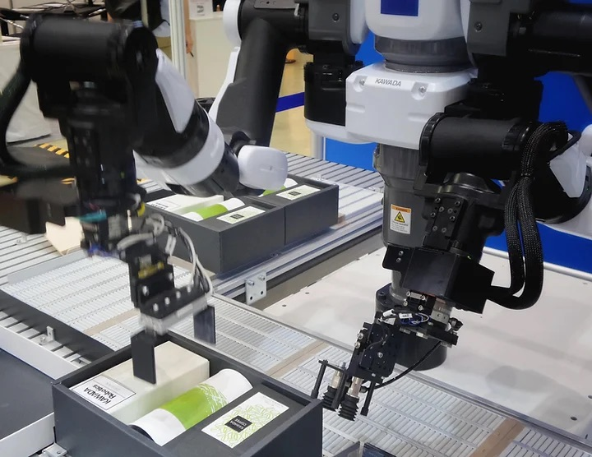
Applications Beyond Retail
Manufacturing
Utilize sensors on equipment to collect features such as: temperature, pressure and vibration
Identify recurring patterns in which certain combinations of sensor readings appear together right before the occurrence of a failure
Apply the Apriori algorithm in order to create association rules which show the likelihood of a certain sensor reading combination occurring next to an equipment failure
These measures help prevent costly emergency repairs and reduce maintenance expenses
Notes:
POWERPOINT LAYOUT: TWO CONTENT
Image size 5.5” wide x 3” tall @ 96 ppi [528x288 pixels]

Slide 19

Applications Beyond Retail
Medicine
Use patient records as transactions and symptoms, medications and lab results as features of those particular transactions
Identify frequent items sets or features which indicate co-occurrence
Association rules convey the likelihood of the occurrence of one feature along another one, which helps uncover potential co-morbid conditions
The identification of co-morbidities, particularly in chronic diseases, aids in the development of more efficacious treatment plans
Notes:
POWERPOINT LAYOUT: TWO CONTENT
Image size 5.5” wide x 3” tall @ 96 ppi [528x288 pixels]

Slide 20

Applications Beyond Retail
Telecom
Analyze customer data and look for relationships between tv and internet subscriptions to extract customers which purchase both together
Identify patterns to see the types of specific tv and internet plans purchased by customers
Based on the observed patterns, bundle tv and internet services at relatively affordable prices
By bundling, companies reduce the chance of customers leaving to competitors, in effect, reducing churn
Notes:
POWERPOINT LAYOUT: TWO CONTENT
Image size 5.5” wide x 3” tall @ 96 ppi [528x288 pixels]

Slide 21
Market Basket Analysis Case Study
Objective: To identify product associations in transaction data and explore strategies for bundling and promotional offers.
Tools Used: R packages - arules and arulesViz
Data Source: UCI Online Retail Dataset

Slide 22
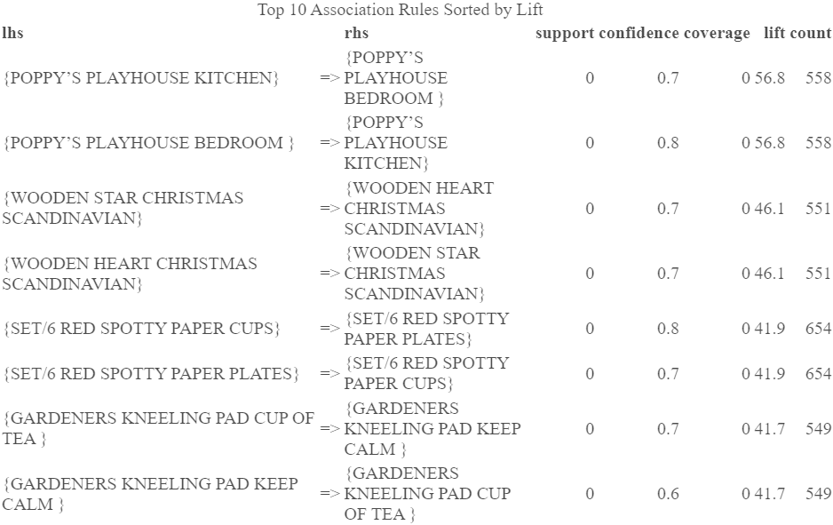
Output
lhs (Left-Hand Side): The set of items or products that form the antecedent of the rule.
rhs (Right-Hand Side): The item or product that forms the consequent of the rule, meaning it is likely to be bought if the lhs items are purchased.
support: The proportion of transactions that include both lhs and rhs items, indicating how frequently this combination occurs.
confidence: The likelihood that the rhs item is purchased when the lhs items are bought, expressed as a percentage.
coverage: The support of the lhs items alone, showing how often the antecedent occurs in the data.
lift: The strength of the association between lhs and rhs, with values greater than 1 indicating that the rhs item is more likely to be bought with lhs items than by random chance.
count: The number of transactions that contain both lhs and rhs items.

Slide 23
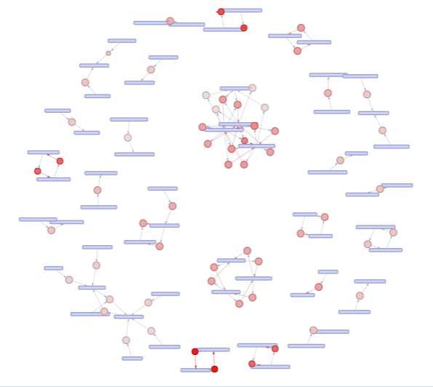
Key Insights & Strategic Implications
High Lift Values: The analysis reveals strong associations between items, such as the POPPY'S PLAYHOUSE series and RED SPOTTY PAPER sets, which are ideal candidates for product bundling to boost sales.
Seasonal Trends: Holiday-themed items like WOODEN STAR and HEART CHRISTMAS SCANDINAVIAN highlight opportunities for targeted marketing during peak holiday seasons.
Strategic Marketing Opportunities: Implementing real-time cross-selling and bundling strategies can increase the average order value and enhance the customer experience.
Inventory and Regional Optimization: Insights into transaction concentration in specific regions provide valuable guidance for optimizing inventory placement and tailoring marketing efforts to areas with higher demand.

Slide 24
Importance of Market Basket Analysis
Value Addition:
Customer Behavior: Insights into customer purchasing habits.
Strategic Marketing: Opportunity to create bundles and improve customer satisfaction.
Inventory Management: Optimize stock based on high-transaction regions.
Pricing: Do relationships fall apart among “big ticket” items?
Next Steps:
Experiment with different support/confidence values for deeper insights.
Leverage associations for personalized recommendations and marketing efforts.
Incorporate customer segmentation to refine targeting strategies.

Slide 25
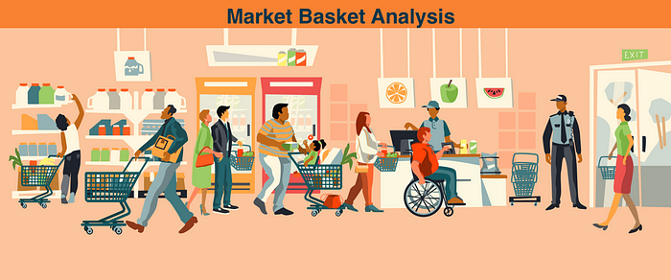
Conclusion
Market Basket Analysis (MBA) has provided deep insights into customer purchasing behavior:
Key item associations reveal opportunities for strategic product bundling and seasonal promotions.
Actionable insights:
By focusing on high-lift rules and strong confidence values, we can prioritize associations that can make a tangible impact on marketing and inventory strategies.
MBA’s versatility extends far beyond retail:
Applications include fraud detection, equipment failure prediction, healthcare analytics, and reducing telecom service churn.
Next steps involve further optimization and customization:
Experimenting with rule parameters and leveraging customer segmentation for personalized marketing strategies.
Thank you!

Slide 26
Sources
Turing. "Market Basket Analysis". Available at: https://www.turing.com/kb/market-basket-analysis
Analytics Vidhya. "A Comprehensive Guide on Market Basket Analysis". Available at: https://www.analyticsvidhya.com/blog/2021/10/a-comprehensive-guide-on-market-basket-analysis/
Towards Data Science. "A Gentle Introduction on Market Basket Analysis & Association Rules". Available at: https://towardsdatascience.com/a-gentle-introduction-on-market-basket-analysis-association-rules-fa4b986a40ce
Analytics Vidhya. "End-to-End Introduction to Market Basket Analysis in R". Available at: https://www.analyticsvidhya.com/blog/2021/10/end-to-end-introduction-to-market-basket-analysis-in-r/
Kaggle. "Online Retail II (UCI) Dataset". Available at: https://www.kaggle.com/datasets/mashlyn/online-retail-ii-uci

